Slide 1
Architecture,ship building,international trade,mining and agriculture in Ancient India

Slide 2
Introduction
The people of ancient India were well versed with what we today call Architecture, Engineering and Technology
The proof of such knowledge can be seen in:
Remains of Mohenjo-daro,,Harappa
Literature sources like Kautilya’s Arthasastra and many more
Religious monuments like Buddhist Stupas, Lingaraj temple
Historical monuments like Ajanta & Ellora, Taj Mahal etc

Slide 3
Indus Valley Civilization (3000-1300) bce
This was the Bronze age. The remains of this era have been unearthed at Mohenja-daro and Harappa-now in Pakistan, Lothal- in Gujrat, Kaliabagan in Rajasthan. Highlights of the then cities were:
Wide paved roads varying from 10m to 5.5m; alignment either north to South or east to west, crossing each other at right angles.
Houses were made from well burnt bricks of different sizes. Most had more than one floor. They had mastered the technique of load distribution. A typical house included a central courtyard, 4-5 living rooms, a paved bath and due provisions for sanitary amenities - a sewer pipe protected by brick ran beneath the floor into the public drains in the street.
Use of pulley wheel for drawing water from the wells was known
Well defined system of weights and measurements were in vogue. Graduated scales made of shell, bronze and ivory have been found. Tera-cotta plumb bobs and instruments for measuring angles of 45,90 & 180 degrees have also been excavated.

Slide 4
Indus Valley Civilization) II
Impressive structures include:
Great Bath at Mohenjo-daro: The dimensions of the Great Bath is about 54mx33m,with a swimming pool measuring 12m x 7m and verandahs on all sides. On each side the pool is a raised platform and flight of steps. The pool was lined with bricks after proper damp proofing treatment.
Great Granary at Harappa: The Great Granary consisted blocks of parallel walls 2.7m wide and 15.9 m long, divided by a passage 7 m broad. The total measurement was 51.5m x 41m
Marine architecture In Lothal: Defense mechanism against floods - the town was raised on mud bricks and thick mud walls reinforced with burnt bricks. Dock with a wharf 260m long and a warehouses of floor area 1,930m². The dock was built off the main stream to avoid silting and flooding. Ships would enter the dock at high tide and there was a mechanism to float the ships at low tide. The inner walls were vertical so that cargo could be loaded and unloaded directly. The warehouse was adjacent to the dock and stood on a 4m high platform. There were 64 blocks of mud-brick, each block 3.6m² and 1m high, interspersed with 1m wide passages to allow ventilation and easy access to goods

Slide 5
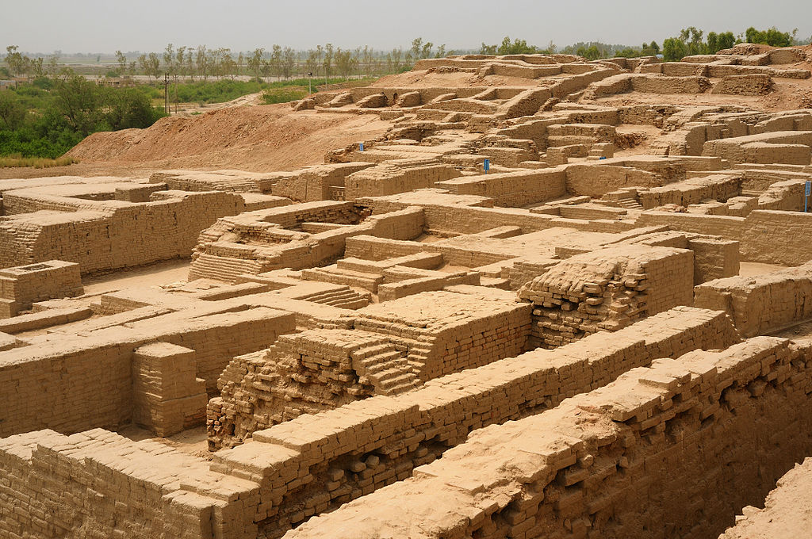
Ruins of Mohen-ja-daro

Slide 6
Literary sources
The Vedic people were mainly pastoral. Still there were references of private houses mainly constructed of wood. The houses were spacious with arrangement for water supply. References of forts and detailed descriptions of chariots with names of its different parts were also found.
In the post Vedic period, references of towns and cities (janapadas) are found. Around 7th century bce, important janapadas like Ayodha, Varanasi, Ujjaini, Vaishali etc flourished.
Kautilya’s Arthasatra (4th cebtury bce)gives us an idea of the Indian approach to town planning. Different chapters talk construction of royal buildings and houses for different categories of citizen. Roads of different dimensions were prescribed for different purposes. The layout and organization of forts are portrayed in a meticulous way.
From writings of Fa Hien, we know that by the time Chandragupta II(380-413bce), city life became more and more organized. From the time of Asoka(269-232bce), use of stone became important in buildings

Slide 7
Religious monuments: Buddhist
In the construction of religious edifices like stupas(to heap) and caiitya-grha(altar room), the Buddhists showed their engineering skill.
The early stupas built by Asoka were made of bricks and mud mortar. Later stupas gained in size & grandeur. A solid hemispherical dome (anda) was placed on tiered bases and surmounted by a railed pavilion (Harmica)
The Sanchi stupa(1st century bce) in Mdhya Pradesh is of developed form and included a circular passage and a railing around it with gates(torana). Later specimen showed more ornate forms like in Nalanda and Ratnagiri.
Another Buddhist structure is the caiitya-grha, a stupa–cum-sanctuary. Initially the stupa was the object of worship. Later, an image of Buddha was placed on it. A caiitya-grha usually had an apsidal ground plan with stupa at its apsidal end and a central nave separated from the side aisles by a row of pillars. Many examples of rock cut caiitya-grha still exists.
At Ellora, in Maharastra, the Bishwakarma cave is a developed example of Chaitya-grha with two –tier roof .
The Buddhist temple at Sarnath has a tower 33.4 metres high and with seven clearly marked receding floors demonstrates the engineering skills of those days. The remains of Nalanda, the ancient University town shows a 33.4metre high stupa.

Slide 8
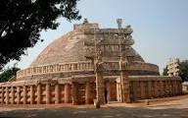
The Sanchi Stupa

Slide 9
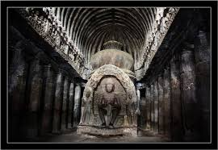
Ellora Biswakarma cave.the Buddhist Chait-grha

Slide 10
Religious monuments: Hindu I
During the Gupta period(300-600 ce), temples were constructed on the basis of the following structural principles
A square sanctum(garbha-grha) for the image
A small pillared portico(mukhamandapa)
A covered circumambulatory passage(pradikshinapatha) around the sanctum.
The early temples had a flat roof. Spire type (Sikhara) came up later.
Early temples were built of stone. Later use of bricks came in vogue
Two broad temple architectural styles emerged
North Indian style called nagara and
South Indian style known as vimana or dravida

Slide 11
Religious monuments: Hindu II
The North Indian temples showed vaulted roof sikharas, linear in elevation. The Rajarani temple & Lingaraj temples have sikharas clustered around the Janga (bottom portion of the spire). The temple components are Ardha-mandapa (entrance porch), mandapa (hall), antarala (vestibule) and the garbhagrha (sanctum).
Khajuraho’s nagara (970-1030ce)style temple in Madhya pradesh has a plain Sikhara with no embellishment of miniature spires (uru-srngas).

Slide 12
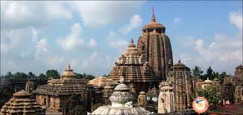
Lingaraj temple,Orissa

Slide 13
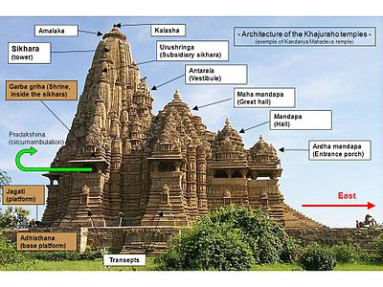
Khajuraho temple –nagara style

Slide 14
The Brahmanical temple in Ellora
Kailasa temple at Ellora (556-773ce),in Maharashtra show the highest artistry and craftsmanship. It was made by cutting away more than 50 million tonnes of rock from the slopping hill by means of hammer and chisel. First, a massive block of stone (60mx30mx30m) was to be isolated, it was then carved from the top downwards and hollowed out in the form of a temple with its intricate carvings.
Brahmanical caves at Badami, Ellora, Elephanta and Mahabalipuram have beautifully curved-out sculpture

Slide 15
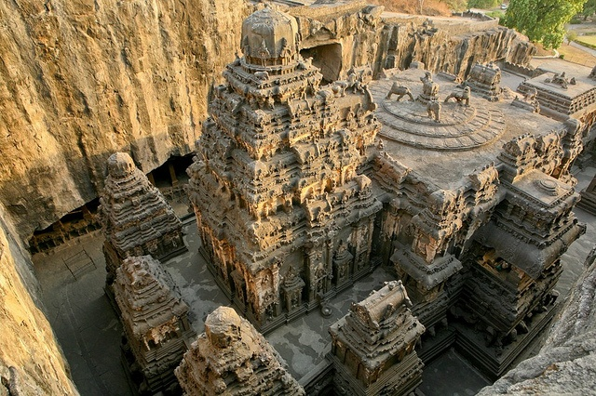
The kailashnath temple ,Ellora

Slide 16
The south Indian temples(Vimana style )
The South Indian temples are characterised by pyramidal sikharas, large mandapas, Gopuram(gateway to the temple enclosure) and nasikas(arched opening above the superstructure wall, projecting over the façade). The shrine is either of salas type (miniature oblong shrine with barrel vault roof or karna-kutas (miniature square shrine at the corner of the roof). A typical temple of this category is found in the Mahabalipuram(Tamil Nadu).

Slide 17
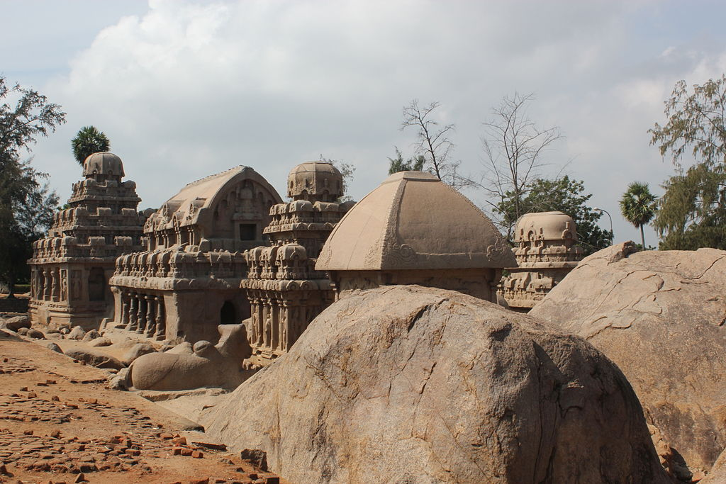
Five rathas in Mahabalipuram

Slide 18
Taj-Mahal,the muslim architecture
Today it is one of the most famous and recognizable buildings in the world
It extends over 55.5 acres and was complete by 1648 ce.
Components of the complex:
Mausoleum: is the symmetrical white marble tomb; a cubic building with chamfered corners, with arched recesses . In plan, it has a near perfect symmetry about 4 axes
It is topped by a large dome(35m in height) and several pillared, roofed chhatris. The dome shape is emphasised by four smaller domed chhatris placed at its corners.
the lower basement chamber containing the tombs of Jahan and Mumtaz,
The main chambercontaining identical cenotaphs of the tombs below in a much more elaborate chamber, an ambulatory storey and a roof terrace.
At the corners of the plinth stand minarets: four large towers each more than 40 metres tall.

Slide 19
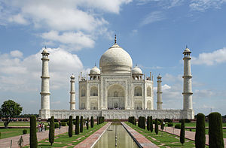

Slide 20
Shipbuilding & sea voyages of Ancient India I
Shipbuilding too has an ancient tradition. We know these from archaeological finds, indigenous literature and accounts of foreigners.
There are evidences that Indus Valley people carried on trade with civilisations of Egypt, Sumer, Persia, Crete and Central Asia. Ruins unearthed at Lothal (once on Arabian Sea)shows the existence of a huge dock. Also seals discovered at Harappa depict ships and anchors meant for deep water use.
Rig-Veda clearly indicates existence of sea vessels and merchants that journeyed across the ocean to distant countries in pursuit of wealth. A kind of vessel called plava is described which can withstand battering of storms. There are descriptions of archaic stabilisers and rudders of a ship.
Astadhyayi makes distinctions were made between coastal island cargoes and mid-ocean Island cargoes. Digha Nakaya( fifth century bce) mentions use of birds by Mariners to ascertain directions.
Arthasastra mentions ship building activities. The navadhyaksa was in charge of navigation in the ocean along with port duties. Vessels were made of timber, bamboo and inflated leather bags.

Slide 21
Shipbuilding & sea voyages II
Stone Inscriptions speak of Emperor Asoka sending abroad missionaries to propagate Buddhism to Sri Lanka. The Pali chronicle Mahavamsa narrates the conquer of Sri Lanka by Vijaysimha of Bengal with seven hundred men. It was later named Simhala after his name.
The cave paintings of Ajanta bear evidence of shipbuilding activities between 2nd and 8th century bce.
The Yukti-kalpataru attributed to king Bhoja (11th century bce), offers an elaborate and analytical study of shipbuilding. It mentions four classes of wood, but only Ksatriya wood which is light but hard and can be joined only with difficulty is recommended for making of ships. It warns about use of iron at the ship bottom. The text divide ships into 2 major categories: Samanya for inland river traffic & Visesa for sea vessels. These two types are again divided into several types and detailed measurement of each of them with their advantages and disadvantages are given in details in this very book.
Also the above text suggests that a ship with four masts should be painted white, that with three red, with two yellow and ship with a single mast should be of blue colour.

Slide 22
Shipbuilding & sea voyages III
The Indian ship builders used various metals like gold, silver, copper to decorate their vessels. Figures of many animals along with celestial figures were carved on the ship body.
Magasthenes’s account speaks of shipbuilders of the Maurya kings. The admiral of the fleet used to let out ships on hire for the transport of passengers and merchandise. Pliny observed that Maurya ships weighed 75 tons. Navigators were aware of the fact that sea between mainland India and island Sri Lanka is not of equal depth and ships were like wise constructed.
The Greek historian Arrian mentions the construction of Dockyard and existence of a tribe called Xathroi(most probably Ksatriyas), who specialized in making oars and transport vessels. They had built Alexander’s thirty-pared galleys and trading vessels to carry the Greek army down the Indus.
The Ain-I-Akbari by Abul I Fazl speaks of maintenance of a naval department by Akbar where sea going ships were constructed. Mogul emperors maintained a well functioning naval department.
Thomas Bowrey, an English traveler to India between 1669 and 1679, has left an account of various types is ships and boats that were made in India.

Slide 23
International trade I
Though India is guarded in the north by massive mountain ranges, yet a number of mountain passes provided natural access from India to Central Asia and to West Asia and China
India’s commercial and cultural contacts with Central Asia, West Asia and Egypt extended to prehistoric times. International maritime trade with the Roman Empire flourished
A national highway, Uttarapatha, spanned the whole of North India from Manipur in the north-east to Purusapura (near Peshawar in Pakistan) in the north west. It passed through Maharashtra, Gauda, Pundravardhana, Vaishali, Kapilavastu, Indrapastha,Takxila and Purusapura. From Indraprastha, a branch extended towards Bolan Pass connecting Agroha,and Mulastana (Multan);another turned south towards Arabian Sea via Mathura and Ujjaini. Taxila and Purusapura on either side of the Indus was linked with Tamralipta on Bay of Bengal and with Broach and Minnagara on Arabian Sea.
Taxila,the capital city of Gandhara, played an important and strategic position in the inland and foreign trade. The most important western route passed through Purusapura and Kapista to Bactria. Purusapura was like gateway to India, being situated at the entrance of the all weather Khyber Pass.

Slide 24
International trade II
Around 2nd century bce, Bactria developed into an international trading centre and a clearing mart for Indian goods. It was the normal converging point of several routes like Babylon-Bactria, Susa-Heart-Bactria in the west and Tashkent-Samarkand –Bactria in the north, and a number of routes from Kashgarh on the west.
Sea route: India had a trade relation with Sumerian cities through maritime activities along the Persian Gulf. These can be ascertained from archaeological finds at Mohenjo-daro, Harappa, and extensive literature dug up in the cities of Mesopotamia.
The most popular items of International trade were Pepper, Ginger, Cardamom, Cinnamon, Gum-resins, Indigo, sugar, fragrant woods like ebony, teak and sandalwood, Copper ,Iron and steel, precious stones like diamond, quartz, opal and crystallised silica.

Slide 25
Mining
Evidence of mining in ancient India is strictly circumstantial. Hatti gold mine (c760bce)in Karnataka and the Dariba copper mine area in Rajastan(c1260bce) have been properly dated
Gold, silver, copper, tin and lead were known to the Indus Valley people. Ganeshwaran site in Rajastan yielded about one thousand copper objects belonging to middle of third millennium bce. Use of iron started in the middle of 2nd millennium bce.
Literary data supports this archaeological evidence. Arthashastra captures in detail issues like gems- testing, mining equipment, mineral handling etc. There are references to mines of diamond, gold, ruby, diamond, copper, lead and iron in Ain-I-Akbari
Geological literature has many references to ancient mine workings encountered in course of field work. Some of these sites are:- a) Baragunda & Moasbani copper mines (Singbhum), b) Gnigundala copper mine (Guntur), c) Wynad goldfields (South India), d) Gavulabhavi lead deposit(Andhra Pradesh, e) copper workings in Kulu (Himachal Pradesh)

Slide 26
Agriculture I
Agriculture was the corner stone of the Indus Valley Civilisation economy. The crops cultivated were wheat, barley, peas, lentils, flax and cotton while among the fruits grown were date and melon.
The variety of wheat unearthed at Mohenjo-daro & Harappa is still cultivated in Punjab. Charred rice grains was discovered in Lothal & Rangpur in Gujrat. This is the oldest record of use of rice in the world.
In the Vedic period agriculture was the chief occupation of people. Rig Veda mentions:
Sowing of grain by means of plough (drawn by 6, 8 or 12 oxen),
use of manure and importance of irrigation,
conservation of rain water and digging wells,
rotation of crops in a particular land and fallowing to restore its fertility,
use of sickle to cut ripe grains and binding in bundles,
beating the harvested crop on the floor of the granary to separate the grain from the straw.

Slide 27
Agriculture II
Yajur-Veda mentions 12 grains: Vrihi (rice), yava (barley), godhuma (wheat), masura (lentil), tila (sesame) etc some among them.
Taittiriya Samhita mentions agricultural seasons - barley to ripen in summer, rice in autumn, beans and sesame in winter. It is mentioned that in a course of year, two crops can be harvested in the same field.
The post Vedic literature provides more detailed information on agriculture in its different aspects: land and soil, manure, tillage ,crops and seeds, irrigation, protection of crops from diseases and pests.
Land and soil: Panini(5th century bce) refers to cultivated land (karsa), wasteland( usara) and pasture (gocara). Susruta & Charaka(1st century ce) divided land into jangala (barren), anupa (moist) & sadharana (ordinary)
Manure: Kautilya suggests use of bone & cow dung. Agni Purana refer to application of fish, animal excreta, bone, beef. Bharat Samhita identified usefulness of seed treatment prior to sowing
Tillage: Arthasastra speaks of field preparation by ploughing the field 3 times in heavy rains. Mahabhasya suggests the use of oxen for ploughing and removal of weeds, stones, thorns prior to ploughing

